Slide 1
Streams and Serialization
Assignment 3
CPRG304 – Object-Oriented Programming III

Slide 2
I/O Streams
Most I/O in Java operates through streams
Read/write sequentially
No inherent blocking (forming) into records or lines
No direct access to any locations in the file other than the next position
Unified way of processing for any type of streams
Files, network sockets, inter-process communications (IPCs) etc.
RandomAccessFile
Read/write arbitrary locations

Slide 3
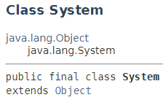
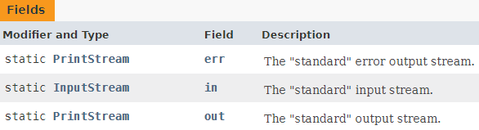
Predefined Java Streams
Exist in every program
Doesn’t require to be instantiated
Created by the JVM on initialization for the computing environment it’s running on
Notes:
PrintStream is a subclass of OutputStream

Slide 4
2 Types of I/O Streams
Streams
Why?
Binary computers: we can only store sequences of 0’s and 1’s
But we can represent (encode) and interpret (decode) these sequences in different ways!
E.g. the number 1024
Binary: 0b 0100 0000 0000 – 12 bits
ASCII: 0x 31 30 32 34 (or decimal 49 48 50 52) – 4 bytes (32 bits)*
Byte-oriented
Character-oriented
Notes:
Which type of streams does Object streams use?
*simplified example… the number of bits needed to encode a value depends on the type of system and the specific type of encoding used (e.g. 8-bit ASCII, 16-bit Unicode, etc.)

Slide 5
Character-Oriented Streams

Slide 6
Byte-Oriented Streams
Notes:
Which are used for what?
File: files on the file system (hard drive)
Data: primitive types and strings
Object: object serialization

Slide 7
Sequential File I/O
Before you can use a file, you must associate the file with a FileInputStream or FileOutputStream object:
FileInputStream fis = new FileInputStream(“file.dat”);
File f = new File(“file.dat”);
FileInputStream fis = new FileInputStream(f);
Which is better?
File object is immutable and can perform checks when requesting access to the file (i.e. throws exception)
Platform-independent (e.g. “/res” or “\res”)
Notes:
The file class also provides security restrictions provided by the JVM!

Slide 8

Chaining
Connecting the output of one stream to the input of another stream
Makes streams more powerful:
Conversion
Byte stream → InputStreamReader → Char stream
Char stream → OutputStreamWriter → Byte Stream
Improve performance
Buffer of bytes or chars to reduce I/O overhead
BufferedInputStream, BufferedOutputStream
BufferedReader, BufferedWriter
Notes:
Default buffer size=8192 bytes, outputs when the buffer is full, or flush().

Slide 9
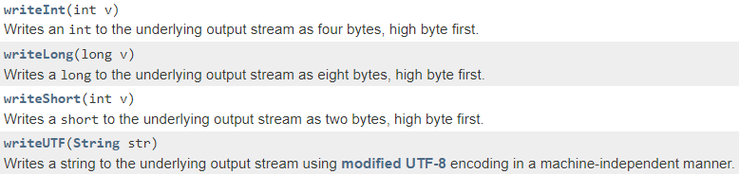
Data Streams
DataInputStream an DataOutputStream are used for primitive data types and Strings

Slide 10
Object Streams
ObjectInputStream an ObjectOutputStream are used for converting objects into a byte-stream or vice versa
i.e. Serialization (writeObject()) and Deserialization (readObject())
Only objects that implement the Serializable interface can be pass through these streams
Most core classes in java.lang implements Serializable except:
Math
System, Runtime
Process, Thread, ThreadGroup
SecurityManager
Notes:
Since serialization is really taking a snapshot of an object (its current state) and turning it into a stream for persistence or transportation, it doesn’t make sense for some classes with states that are tie to the computing environment or current session to be serialized.

Slide 11
Serialization
Definition: The process of converting an object into a stream of bytes
To persist or transmit
Save to a file or object in a database
Transfer over a network
Why?
To be reconstructed later!
Deserialization

Slide 12
Suppressing Serialization
Not every attribute in a class need to be serialized
Why?
Qualifier transient
Excludes attribute from serialization
What will happen to transient attributes when the object is deserialized?
Restored to the default value of that data type
char, byte, short, int, long – 0; float, double – 0.0; boolean – false; String – null; Object – null
Notes:
Check out SerializationExample.

Slide 13
Customizing Serialization
Direct control of how each object will be serialized and/or deserialized
i.e. manipulating the byte stream
Example: encrypting a value using Caesar’s cipher
Private String encrypt(String input, int offset) {
StringBuffer sb = new StringBuffer();
for( int n = 0; n < input.length(); n++ ) {
sb.append((char)(offset + input.charAt(n)));
}
return sb.toString();
}
Notes:
Just a simple encryption algorithm, you can (and should) use a much better one!

Slide 14
Customizing Serialization
Inside serializable class, implement the following 2 methods:
private void writeObject(ObjectOutputStream oos) throws IOException {
String newString = encrypt(oldString, 5);
oos.defaultWriteObject();
}
private void readObject(ObjectInputStream ois) throws IOException, ClassNotFoundException;
private void readObjectNoData() throws ObjectStreamException;
Notes:
readObjectNoData method allows a class to control the initialization of its own fields, can be defined by each serialized class to reinstate the deserialized objects instead of the default values for that data type
Only one of the readObject methods would be invoked
noData is specifically for objects that have missing fields due the its superclass not being there in the destination during deserialization (but was in the source when it’s serialized)

